Slide 1


C# 8 & Beyond
Filip Ekberg

Slide 2





Filip Ekberg
Microsoft MVP
@fekberg
free @ filipekberg.se

Slide 3
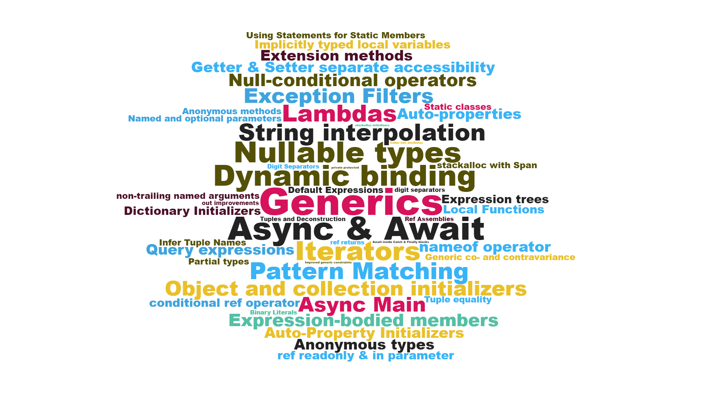
Notes:
Quick rundown on all the amazing features included in C# as a language
How this is possible due to the Roslyn compiler efforts (Microsoft Compiler Platform)
We will discuss a few features introduced in C# 7.0 (Pattern Matching, and Deconstruction) as this leads into improvements in C# 8.0

Slide 4
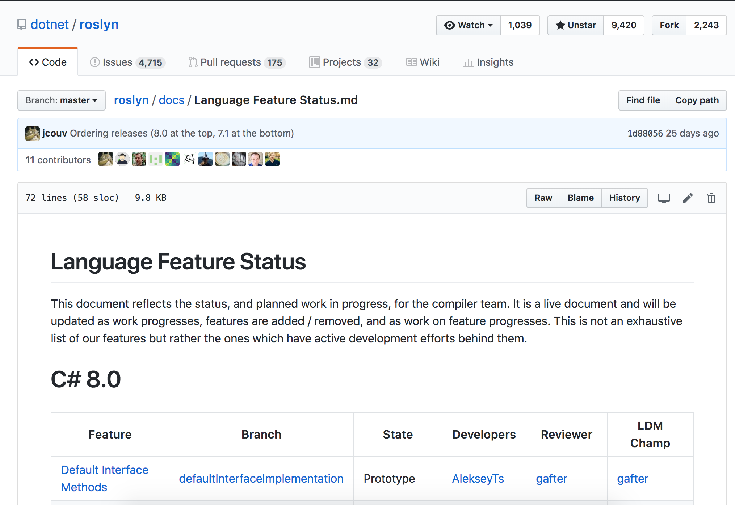
Notes:
The language is being built on in the open, on github
Taking feedback, issues and having discussions with the community

Slide 5
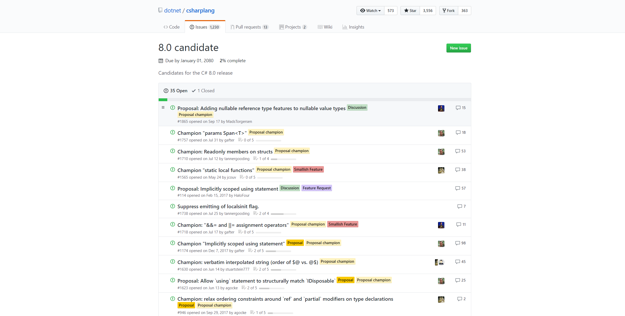
Notes:
The C# 8.0 candidate has a lot of Champions, features that most likely will not be included
A few of these will be done by the time C# 8.0 hits the market

Slide 6
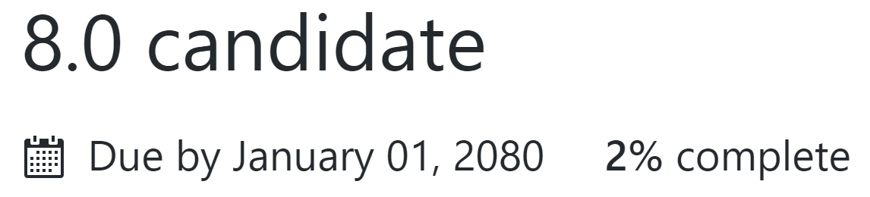
Notes:
Talk about the csharplang repo on github
When will this potentially be released? Probably with the next version of VS

Slide 7

Notes:
Same time as .NET Core 3.0
With VS 2019

Slide 8

Notes:
DEMO!
Introduction to Pattern Matching, Tuples and Deconstruction from C# 7.0
5 minutes
Recursive patterns
5 minutes
Ranges
5 minutes
Null reference type
5 minutes

Slide 9
Async streams
var enumerable = GetAsynchronousEnumerable();
await foreach (T item in enumerable)
{
}
https://github.com/dotnet/csharplang/blob/master/proposals/async-streams.md

Slide 10
Async streams
var enumerator = enumerable.GetAsyncEnumerator();
try
{
while (await enumerator.MoveNextAsync())
{
T item = enumerator.Current;
...
}
}
finally
{
await enumerator.DisposeAsync();
}
https://github.com/dotnet/csharplang/blob/master/proposals/async-streams.md

Slide 11
Target-type new expression
Triangle triangle = new();
Dictionary<string, List<int>> field = new() {
{ "item1", new() { 1, 2, 3 } }
};
https://github.com/dotnet/csharplang/blob/master/proposals/target-typed-new.md

Slide 12
default in deconstruction
(int age, string name) = (default, default);
(int age, string name) = default;
https://github.com/dotnet/csharplang/issues/1394

Slide 13
Generic attributes
public class CustomAttribute : Attribute
{
public CustomAttribute(Type t)
{
}
}
public class CustomAttribute<T> : Attribute {}
https://github.com/dotnet/roslyn/issues/953

Slide 14
Caller expression attribute
void Assert(bool condition, [CallerArgumentExpression("condition")]
string message = null);
Debug.Assert(array != null);
Debug.Assert(array.Length == 1);
Debug.Assert(array != null, "array != null");
Debug.Assert(array.Length == 1, "array.Length == 1");
https://github.com/dotnet/csharplang/blob/master/proposals/caller-argument-expression.md

Slide 15
Enhanced using (pattern-based using)
Doesn’t implement IDisposable!
class Resource
{
public void Dispose() { ... }
}
using (var resource = new Resource())
{
}
https://github.com/dotnet/csharplang/blob/d2ce4cc3e17708e7e1d062bf40da0901a744fa3b/proposals/using.md

Slide 16
Default interface methods
interface IAuthentication
{
// Version 1
User Authenticate(Credentials credentials);
// Version 2
Task<User> AuthenticateAsync(Credentials credentials) => Task.FromResult<User>(default)
}
class Authenticate : IAuthentication
{
public User Authenticate(Credentials credentials) => ...
}
IAuthentication auth = new Authenticate();
var user = await auth.AuthenticateAsync();
https://github.com/dotnet/csharplang/issues/52

Slide 17
Null coalescing assignment
x = x ?? y
if(x == null) x = y;
x ??= y
https://github.com/dotnet/csharplang/blob/master/proposals/null-coalescing-assignment.md

Slide 18
As well as..
Switch expressions
Relax ordering of ref and partial modifiers
Alternative interpolated verbatim strings
stackalloc in nested contexts

Slide 19

Notes:
So what’s next?
C# X – they’ll probably skip 9 as they did with Windows (obvious joke)

Slide 20

Don’t be sad when they don’t make the cut

Slide 21
Negated-condition if statement
if( !(shape is Triangle) ) {};
if(shape is not Triangle) {};
if!(shape is Triangle) {};
unless(shape is Triangle) {};
https://github.com/dotnet/csharplang/issues/882

Slide 22
Null-conditional await
(task == null) ? null : await task
await! task
https://github.com/dotnet/csharplang/issues/35

Slide 23
Record Types
public class Triangle : Shape
{
public int A { get; }
public int B { get; }
public int C { get; }
public Triangle(int a, int b, int c)
{
A = a;
B = b;
C = c;
}
}
public class Triangle(int A, int B, int C) : Shape {}
https://github.com/dotnet/csharplang/issues/39
Notes:
- Immutable!

Slide 24
Record Types
public class Triangle : Shape, IEquatable<Triangle>
{
public int A { get; }
public int B { get; }
public int C { get; }
public Triangle(int a, int b, int c)
{
A = a; B = b; C = c;
}
public bool Equals(Triangle other)
=> other != null && Equals(A, other.A) && Equals(B, other.B) && Equals(C, other.C);
public override bool Equals(object other) => this.Equals(other as Triangle);
public override int GetHashCode() => A.GetHashCode() * 17 + B.GetHashCode() + C.GetHashCode();
public Triangle With(int A = this.A, int B = this.B, int C = this.C) => new Triangle(A, B, C);
public void Deconstruct(out int A, out int B, out int C) { A = this.A; B = this.B; C = this.C; }
}

Slide 25
Declaration expressions
char ch;
while ((ch = GetNextChar()) == 'a'
|| ch == 'b'
|| ch == 'c')
{ }
while ((char ch = GetNextChar()) == 'a'
|| ch == 'b'
|| ch == 'c')
{ }
https://github.com/dotnet/csharplang/issues/973

Slide 26
Dictionary literals
var x = new Dictionary<string, int>() {
{ "foo", 4 },
{ "bar", 5 }
};
var x = ["foo":4, "bar": 5];
https://github.com/dotnet/csharplang/issues/414

Slide 27
As well as..
Type classes
readonly struct members
params Span<T>
static local functions
&&= and ||= assignment operators

Slide 28
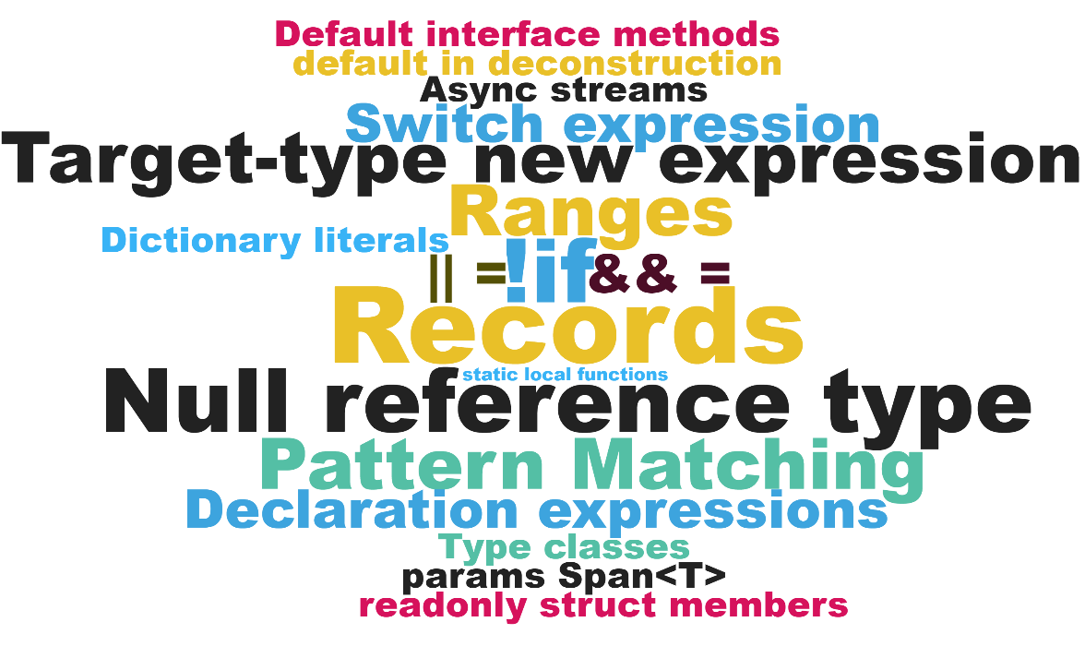
C# 1 => 7.3
C# 8 => n

Slide 29

Thanks!
I’m Filip Ekberg
@fekberg
free @ filipekberg.se

